Slide 1
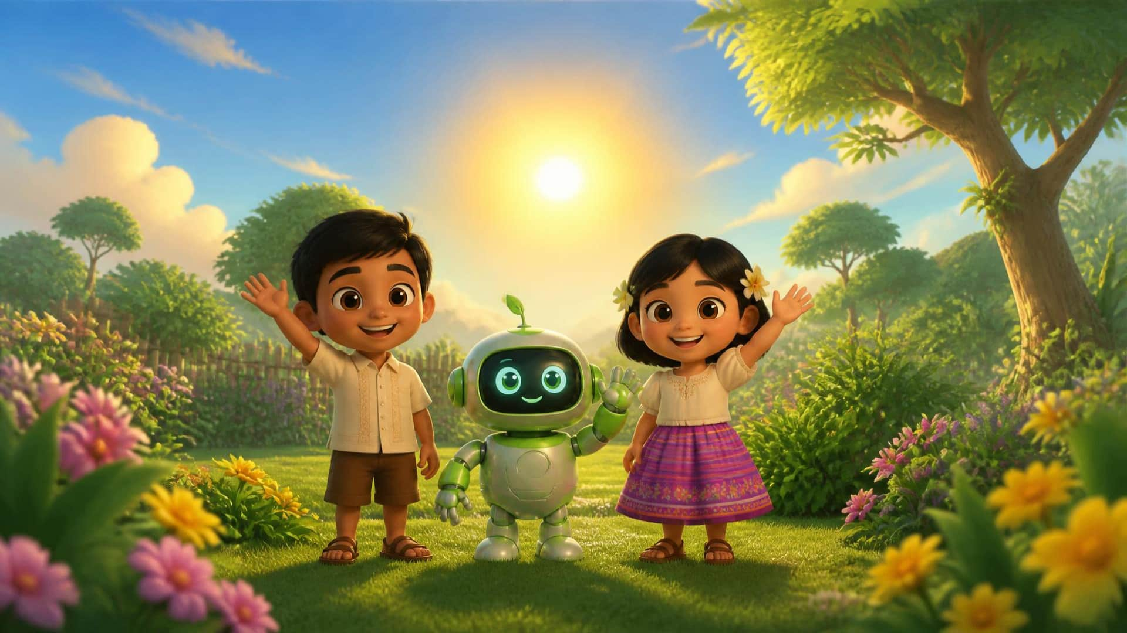

1 / 13
LESSON 13 – The Yellow Sun
LITTLE SEEDS! MONTH 1

Slide 2

LESSON 13 – The Yellow Sun
2 / 13
Sun
LITTLE SEEDS! MONTH 1

Slide 3
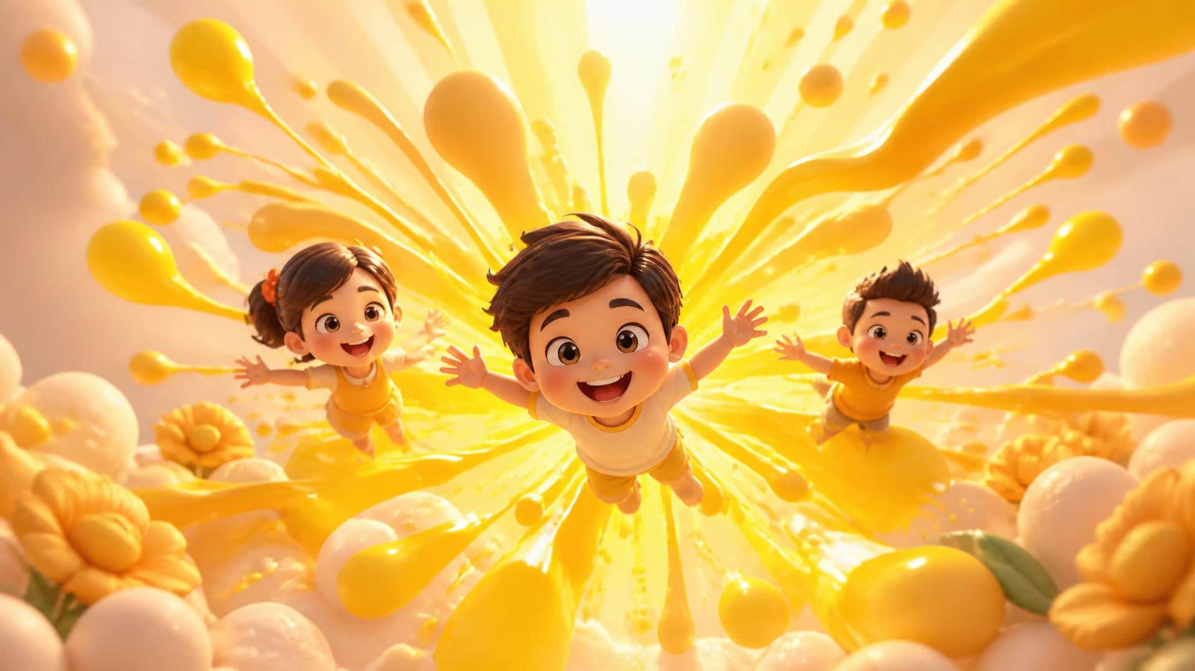
LESSON 13 – The Yellow Sun
3 / 13
Yellow
LITTLE SEEDS! MONTH 1

Slide 4
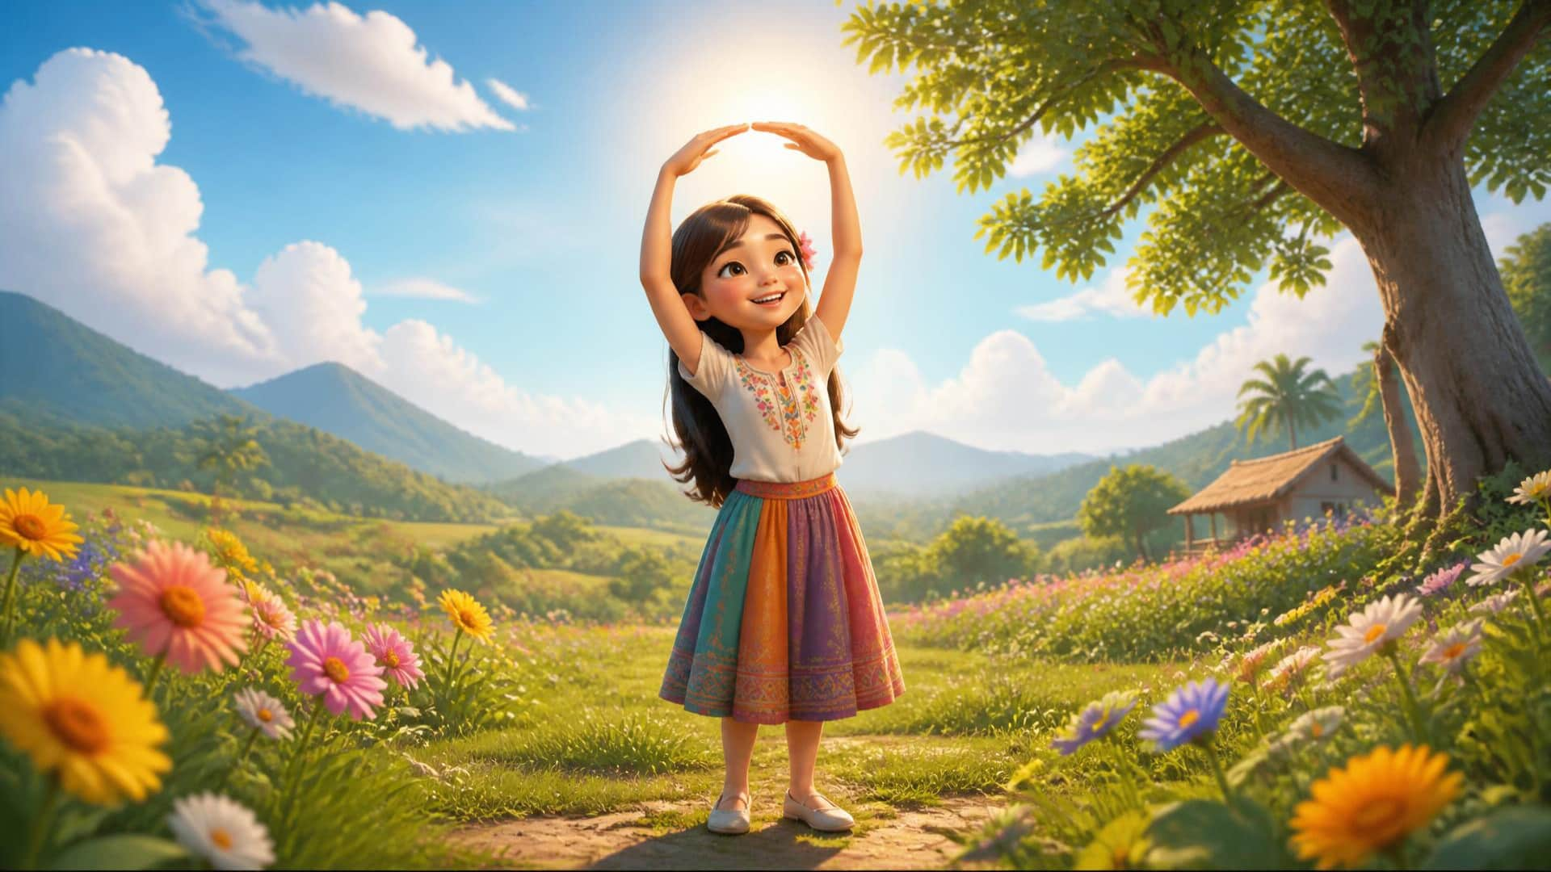
LESSON 13 – The Yellow Sun
4 / 13
Yellow Sun
LITTLE SEEDS! MONTH 1

Slide 5
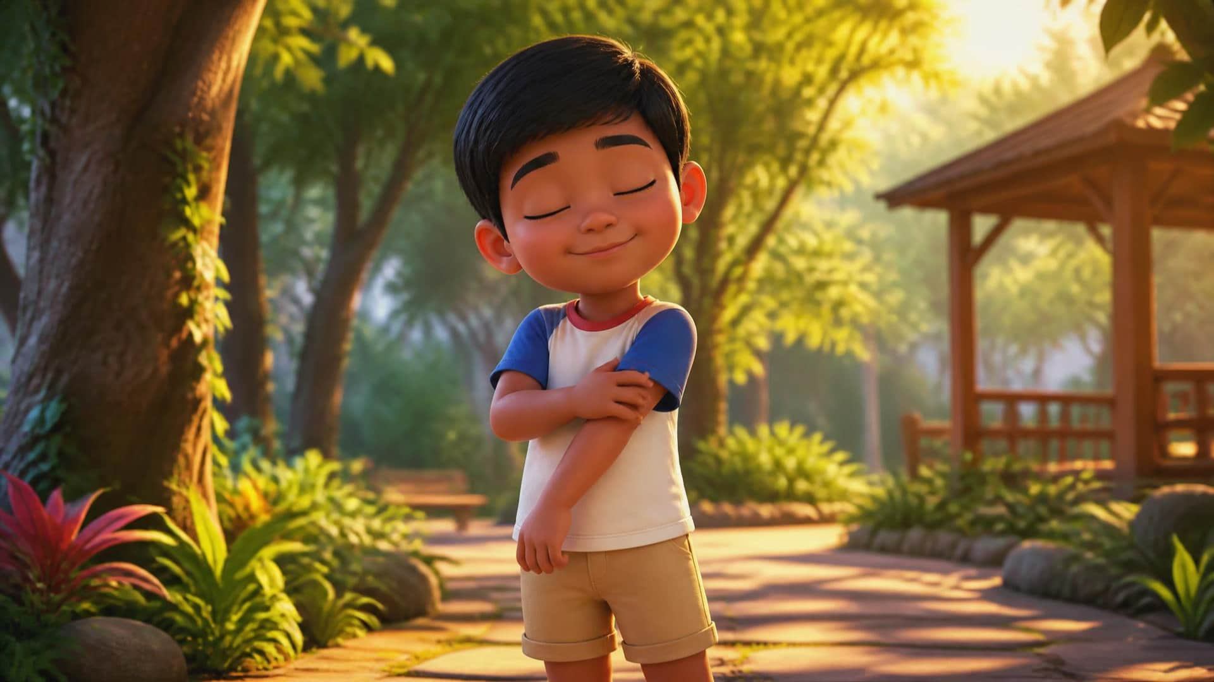
LESSON 13 – The Yellow Sun
5 / 13
Warm
LITTLE SEEDS! MONTH 1

Slide 6
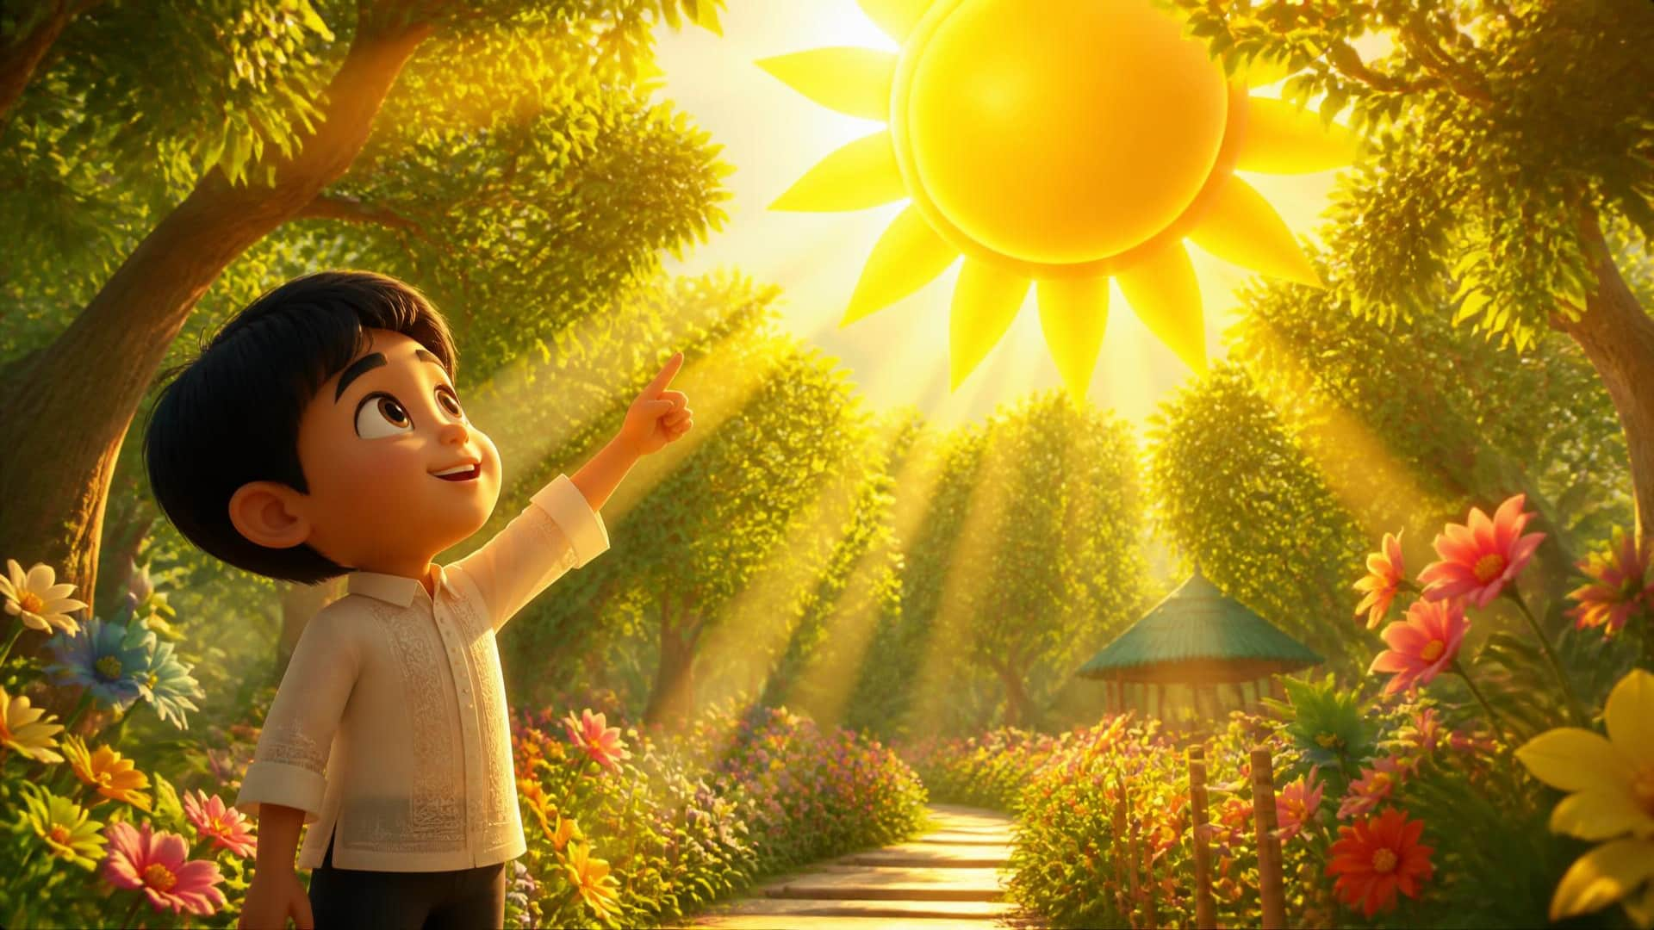
LESSON 13 – The Yellow Sun
6 / 13
God made the yellow sun.
LITTLE SEEDS! MONTH 1

Slide 7
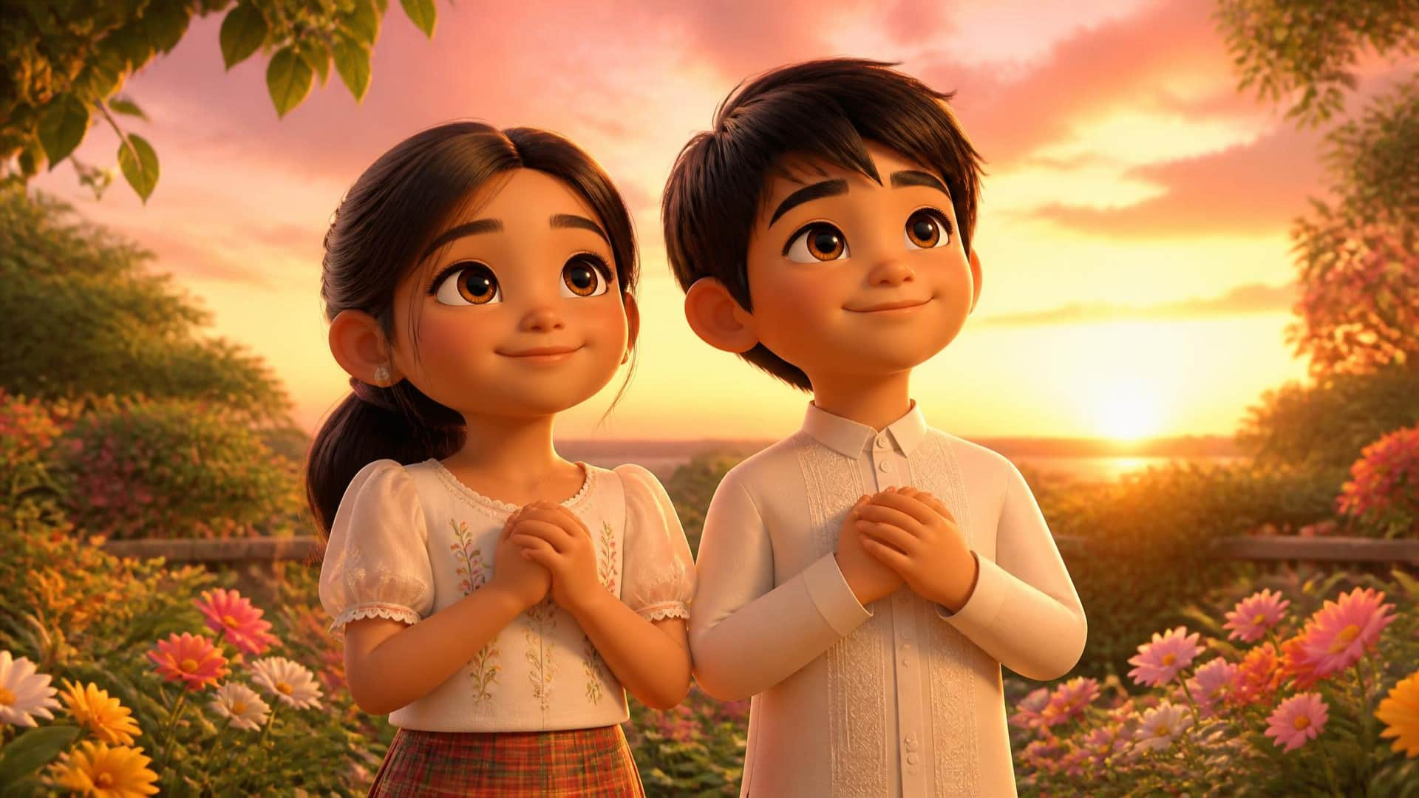
LESSON 13 – The Yellow Sun
7 / 13
Thank you, God!
LITTLE SEEDS! MONTH 1

Slide 8
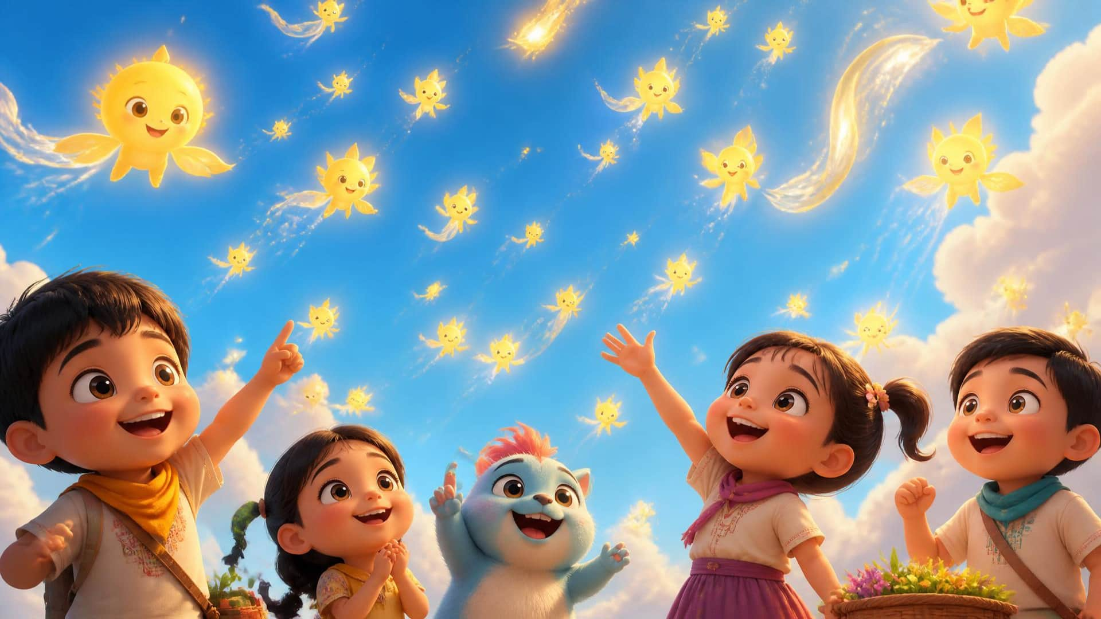
LESSON 13 – The Yellow Sun
8 / 13
Catch them!
LITTLE SEEDS! MONTH 1

Slide 9
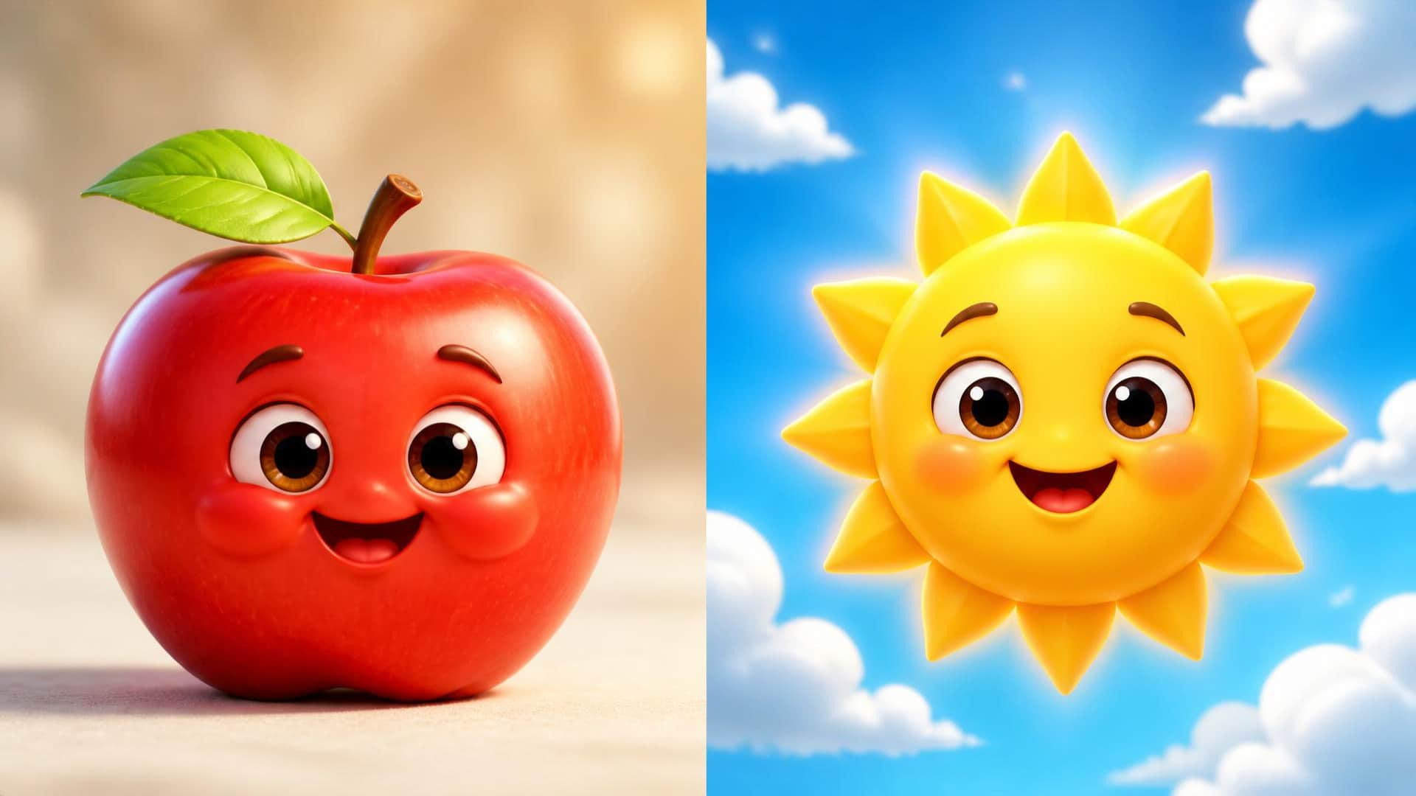
LESSON 13 – The Yellow Sun
9 / 13
Where is Yellow?
LITTLE SEEDS! MONTH 1

Slide 10

LESSON 13 – The Yellow Sun
10 / 13
Where does the sun go?
LITTLE SEEDS! MONTH 1

Slide 11
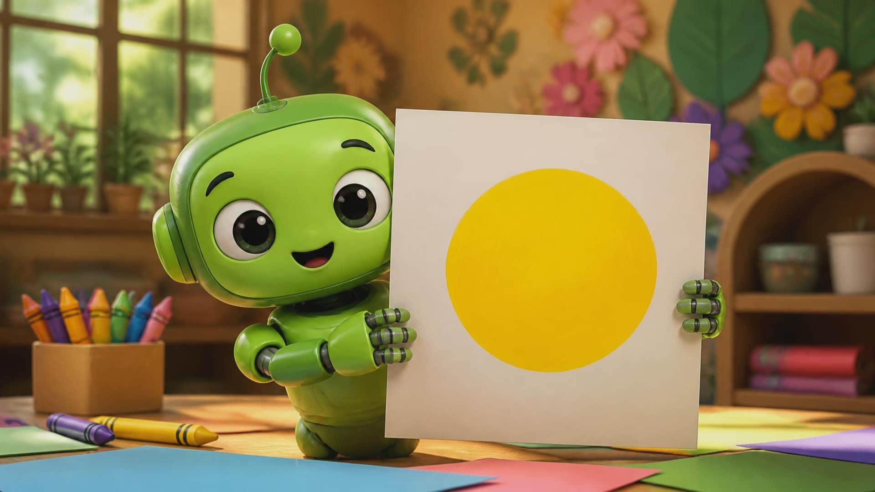
LESSON 13 – The Yellow Sun
11 / 13
Your turn!
LITTLE SEEDS! MONTH 1

Slide 12
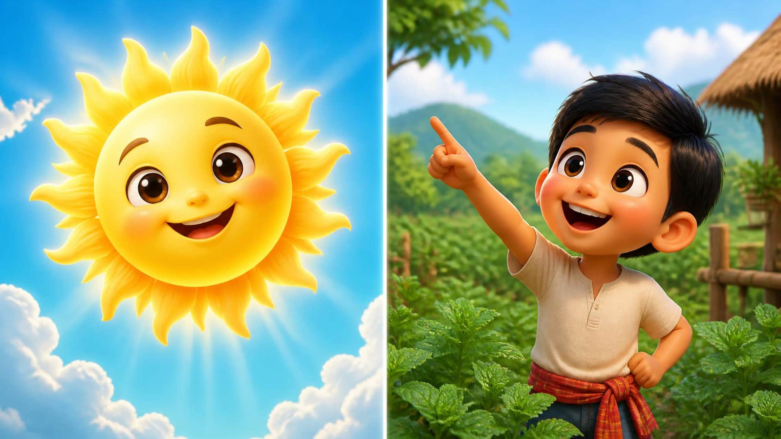
LESSON 13 – The Yellow Sun
12 / 13
Yellow Sun. God made the yellow sun.
LITTLE SEEDS! MONTH 1

Slide 13
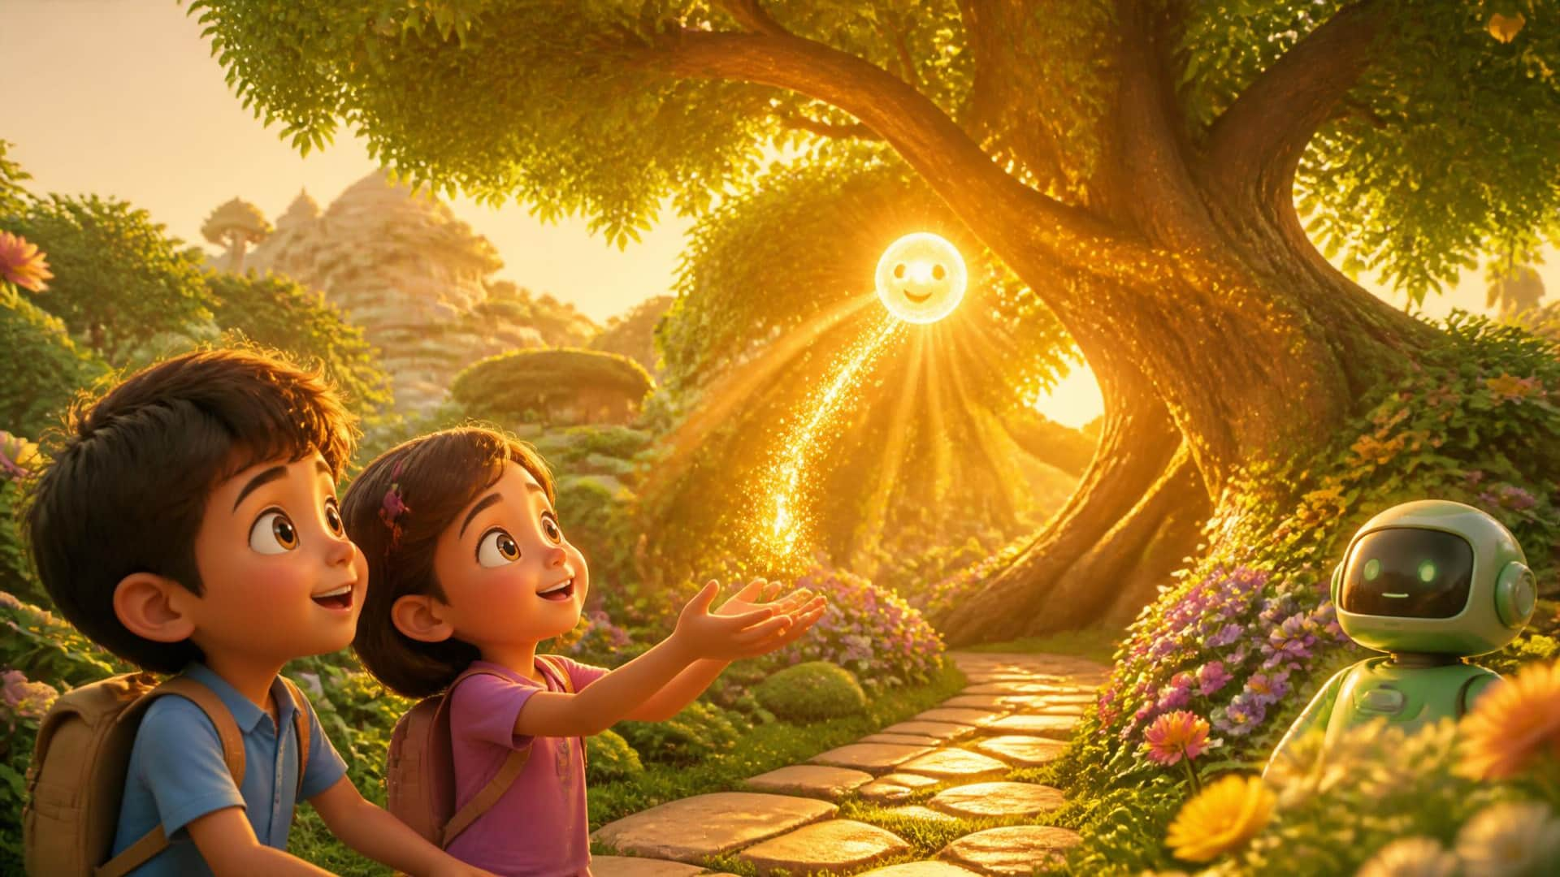
LESSON 13 – The Yellow Sun
13 / 13
Goodbye!
LITTLE SEEDS! MONTH 1

